Slide 1

Exploring the Effect of Horsepower and Vehicle Weight
By Hanna Bohannon

Slide 2
Overview
Horsepower
Vehicle Weight
Conclusion Statement

Slide 3
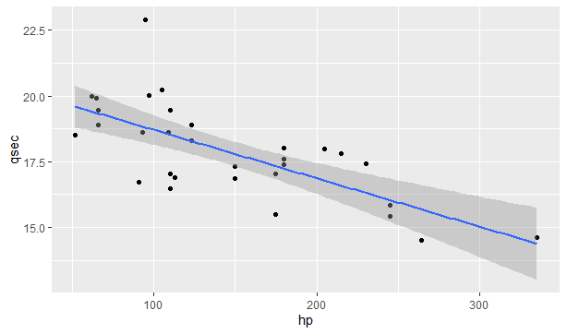
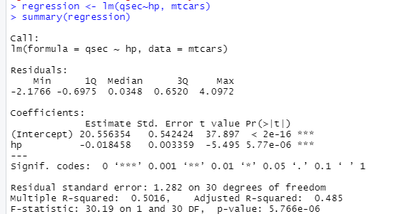
Effect of Horsepower on Quarter Mile Time
There’s a Negative Correlation in this plot.
ggplot(data=mtcars, aes(x = hp, y = qsec)) + geom_point() +
geom_smooth(method='lm', se = TRUE)
There’s a 49% variance in the Quarter Mile Time.

Slide 4
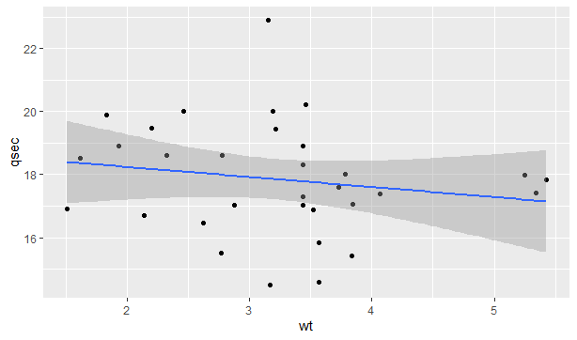
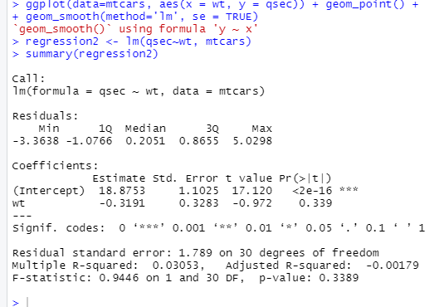
Effect of Vehicle Weight on Quarter Mile Time
There’s a Uncorrelation in this plot.
ggplot(data=mtcars, aes(x = wt, y = qsec)) + geom_point() +
geom_smooth(method='lm', se = TRUE)
There’s a 0% variance in the Quarter Mile Time.

Slide 5
Conclusion Statement
The horsepower of a car has a significant influence on quarter mile start times verses
the weight of the vehicle. The two key ingredients for speed are horsepower and aerodynamics. Oh, and a great race driver!

